Slide 1


VEHICLE SHOWROOM MANAGEMENT SYSTEM
V SEMESTER DATABASE MANAGEMENT SYSTEM –MINI PROJECT
Course Code:18CSL58
Team Members
Rehan Nadeemulla 1MV19CS092
Shrey Raj 1MV19CS102
DEPARTMENT OF COMPUTER SCIENCE AND ENGINEERING
2021-2022, Odd Semester

Slide 2
SIR M. VISVESVARAYA INSTITUTE OF TECHNOLOGY
Krishnadevaraya Nagar, International Airport Road, Hunasmaranahalli, Bengaluru – 562157 DEPARTMENT OF COMPUTER SCIENCE AND ENGINEERING
CERTIFICATE
It is certified that the DBMS Mini Project work entitled " VEHICLE SHOWROOM MANAGEMENT SYSTEM " is carried out by SHREY RAJ & REHAN NADEEMULLA are bonafide students of Sir M Visvesvaraya Institute of Technology in partial fulfillment for the 5th semester for the award of the Degree of Bachelor of Engineering in Computer Science and Engineering of the Visvesvaraya Technological University, Belagavi during the academic year 2021-2022.It is certified that all corrections and suggestions indicated for Internal Assessment have been incorporated in the report deposited in the department library. The project report has been approved as it satisfies the academic requirements in respect of project work prescribed for the course of Bachelor of Engineering.
Dr . Sushila Shidnal Prof & Internal Guide Dept. Of CSE, Sir MVIT Bengaluru - 562157
Dr. G. C. Bhanu Prakash HOD, Dept. Of CSE, Sir MVIT Bengaluru - 562157
Dr. V.R. Manjunath Principal, Sir MVIT Bengaluru – 562157

Slide 3
DECLARATION
We hereby declare that the entire project work embodied in this dissertation has been carried out by us and no part has been submitted for any degree or diploma of any institution previously.
Place: Bengaluru

Slide 4
ACKNOWLEDGMENT
It gives us immense pleasure to express our sincere gratitude to the management of Sir M. Visvesvaraya Institute of Technology, Bengaluru for providing the opportunity and the resources to accomplish our project work in their premises.
On the path of learning, the presence of an experienced guide is indispensable and we would like to thank our guide Dr. Sushila Shidnal, Professor, Dept. of CSE, for her invaluable help and guidance.
Heartfelt and sincere thanks to Dr. G. C. Bhanu Prakash, HOD, Dept. of CSE, for his suggestions, constant support and encouragement
We would also like to convey our regards to Dr. V.R. Manjunath, Principal, Sir. MVIT for providing us with the infrastructure and facilities needed to develop our project.
We would also like to thank the staff of Department of Computer Science and Engineering and lab-in-charges for their co-operation and suggestions. Finally, we would like to thank all our friends for their help and suggestions without which completing this project would not have been possible.

Slide 5
ABSTRACT
Objective:-
This system “Vehicle Showroom Management” allows providing vehicle purchase. If customer wants to purchase a new vehicle based on their choice this project helps the showroom services to function properly and provide customers with full satisfactions.
The real power of this project lies not in direct selling of products, but in the creation of tighter relationships with customers and delivering of a high level of service and support, which in turn improves organization sales and its goodwill. As the number of customers and size of operations increases, the organization divides the geographical area into service areas and branch locations, to allow Engineers to be more responsive to the customer-needs
This project contains 5 modules namely :-
Staff Module
➢ Dealer Module
➢ Vehicle Module
➢ Customer Module
➢ Order Module

Slide 6
TABLE OF CONTENTS
Introduction
Technologies used
Functionalities
System Specifications
ER Diagram
UML Diagram
Database State Snapshots
Results
Conclusion

Slide 7
Introduction:
Our project aims at digitalizing the data of a Vehicle showroom.
The records of the customers and vehicle which were being stored using papers , books and bills which can be misplaced and lost very easily, is replaced with the secure database .
Accessing the details of a particular customer ,dealers , staff and the vehicle that are currently available in the showroom is very difficult task as the data is huge and a person has to go through each and every record to access the information needed.
This motivated us to develop a secure database for the showroom named 4WHEELS MOTORSPORTS.

Slide 8
Technologies Used:
Front-end : HTML and CSS.
Backend: Django.
Database: SQLite.
HTML: The Hyper Text Markup Language, or HTML is the standard markup language for documents designed to be displayed in a web browser. It can be assisted by technologies such as Cascading Style Sheets (CSS) and scripting languages such as JavaScript.
CSS: Cascading Style Sheets (CSS) is a style sheet language used for describing the presentation of a document written in a markup language such as HTML. CSS is designed to enable the separation of presentation and content, including layout, colors, and fonts etc.

Slide 9
Django: is a Python-based free and open-source web framework that follows the model–template–views (MTV) architectural pattern.
Django's primary goal is to ease the creation of complex, database-driven websites. The framework emphasizes reusability and "pluggability" of components, less code, low coupling, rapid development, and the principle of don't repeat yourself.[9] Python is used throughout, even for settings, files, and data models. Django also provides an optional administrative create, read, update and delete interface that is generated dynamically through introspection and configured via admin models.
SQLite: is a relational database management system (RDBMS) contained in a C library. In contrast to many other database management systems, SQLite is not a client–server database engine. Rather, it is embedded into the end program.
SQLite generally follows PostgreSQL syntax but does not enforce type checking. This means that one can, for example, insert a string into a column defined as an integer.

Slide 10
Functionalities:
Admin can access customer details and vehicle details .
Admin can add new Customer, Vehicle, Dealer, Staff.
Admin can modify the details of Customer ,Staff, Dealer.
Admin can take the order of the customer and payment from the customer in various mode.
Admin can search for a particular customer details.
Admin can have a count of total customers , total orders taken today and Total orders overall.

Slide 11
System Specifications
Hardware Requirements:-
• Pentium-IV(Processor).
• 256 MB Ram
• 512 KB Cache Memory
• Hard disk 10 GB
• Microsoft Compatible 101 or more Key Boar
Software Requirements: -
• Operating System : Windows
• Programming language: Django
• Front-End: HTML-CSS
• Back-End: Django
• Web Server: Django Live Server

Slide 12
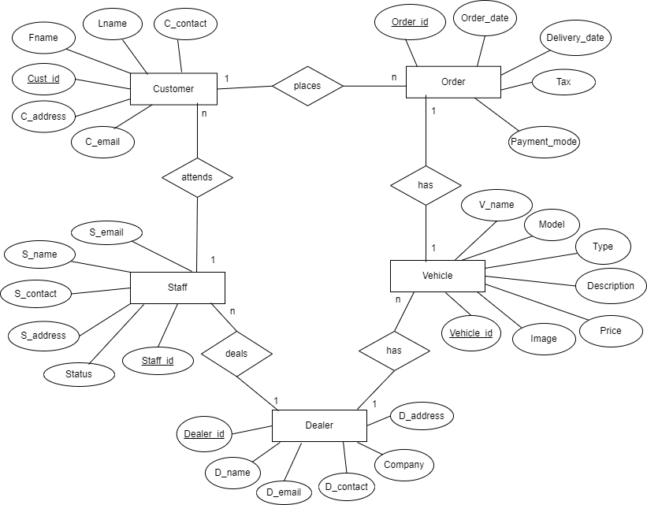
ER DIAGRAM:

Slide 13
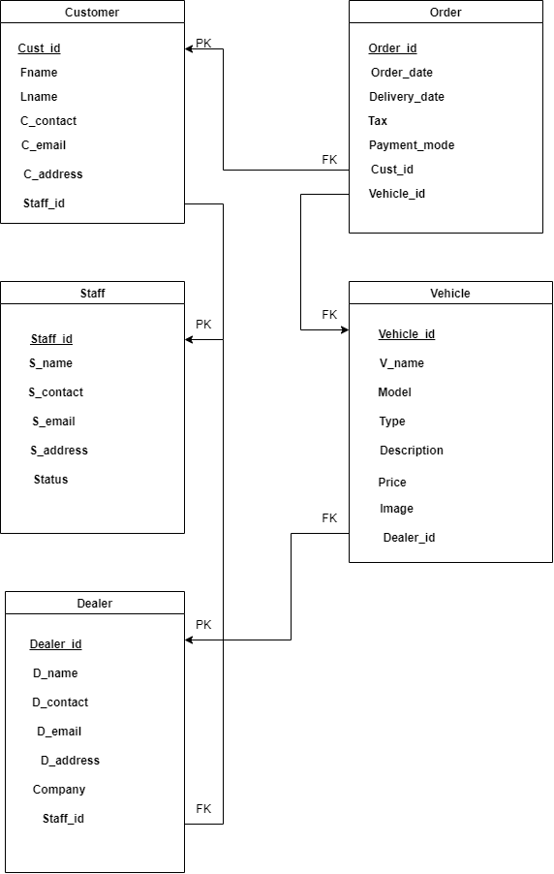
UML DIAGRAM:

Slide 14
Tables Created:
Staff Table:
class StaffModel(models.Model):
STATUS =(
('Active','Active'),
('Inactive','Inactive'),
)
alpha = RegexValidator(r'^[a-zA-Z]*$', 'Please Enter Valid Name')
phone = RegexValidator(r'^[0-9]{10}$', 'Please Enter Valid Mobile Number')
sname = models.CharField(max_length=50 ,validators=[alpha])
semail = models.EmailField()
scontact = models.CharField(max_length=10 , null=True,blank=True,validators=[phone])
saddress = models.TextField()
status = models.CharField(max_length=100,null=True,choices=STATUS)

Slide 15
Dealer Table:
class DealerModel(models.Model):
alpha = RegexValidator(r'^[a-zA-Z]*$', 'Please Enter Valid Name')
phone = RegexValidator(r'^[0-9]{10}$', 'Please Enter Valid Mobile Number')
dname = models.CharField(max_length=50,validators=[alpha])
demail = models.EmailField()
dcontact = models.CharField(max_length=10 , null=True,blank=True ,validators=[phone])
daddress = models.TextField()
dcompany = models.CharField(max_length=50)
staff_name = ForeignKey(StaffModel,on_delete=models.CASCADE,null=True,blank=True)

Slide 16
Vehicle Table:
class VehicleModel(models.Model):
TYPE =(
('Two Wheeler','Two Wheeler'),
('Four Wheeler','Four Wheeler'),
)
vname = models.CharField(max_length=50)
vmodel = models.CharField(max_length=50)
vtype =models.CharField(max_length=100,null=True,choices=TYPE)
vprice= models.FloatField()
vdescription = models.TextField()
vimage = models.FileField(upload_to="image/",null=True, blank=True)
v_dealer = ForeignKey(DealerModel,on_delete=models.CASCADE,null=True,blank=True)

Slide 17
Customer Table:
class CustomerModel(models.Model):
alpha = RegexValidator(r'^[a-zA-Z]*$', 'Please Enter Valid Name')
phone = RegexValidator(r'^[0-9]{10}$', 'Please Enter Valid Mobile Number')
fname = models.CharField(max_length=50 ,validators=[alpha])
lname = models.CharField(max_length=50,null=True,blank=True ,validators=[alpha])
contact =models.CharField(max_length=10 , null=True,blank=True ,validators=[phone])
cemail =models.EmailField()
caddress = models.TextField()
staff_id =ForeignKey(StaffModel,on_delete=models.CASCADE,null=True,blank=True)

Slide 18
Order Table:
class OrderModel(models.Model):
MODE =(
('Cheque','Cheque'),
('Cash','Cash'),
('Net Banking','Net Banking')
)
cust_id = models.ForeignKey(CustomerModel,on_delete=models.CASCADE,null=True,blank=True)
vehicle_name = models.ForeignKey(VehicleModel,on_delete=models.CASCADE,null=True,blank=True)
order_date = models.DateField(default=date.today)
delivery_date = models.DateField(default=date.today)
tax = models.FloatField()
payment_mode = models.CharField(max_length= 60, choices=MODE,null=True,blank=True)

Slide 19
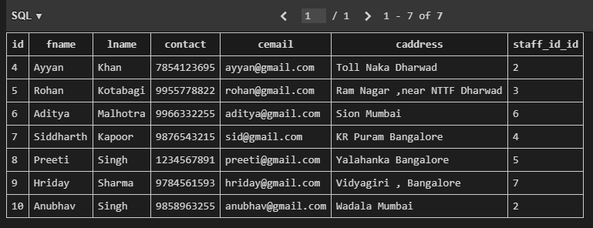
DATABASE STATE SNAPSHOT:
Customer Table:

Slide 20
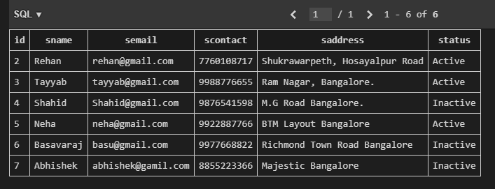
Staff Table:

Slide 21
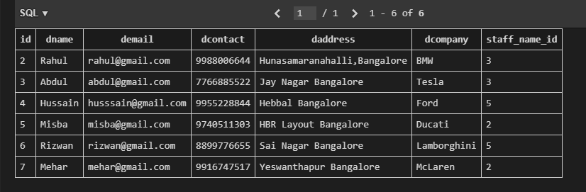
Dealer Table:

Slide 22
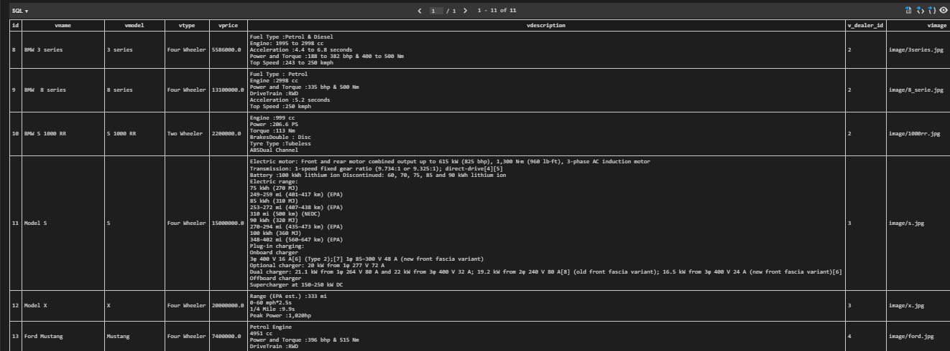
Vehicle Table:

Slide 23
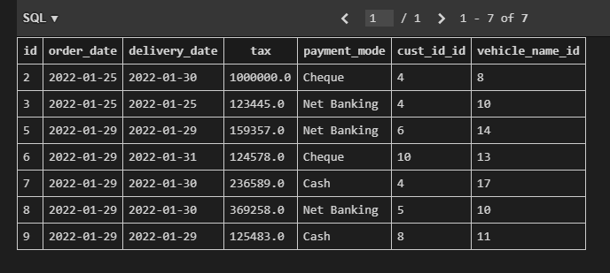
Order Table:

Slide 24
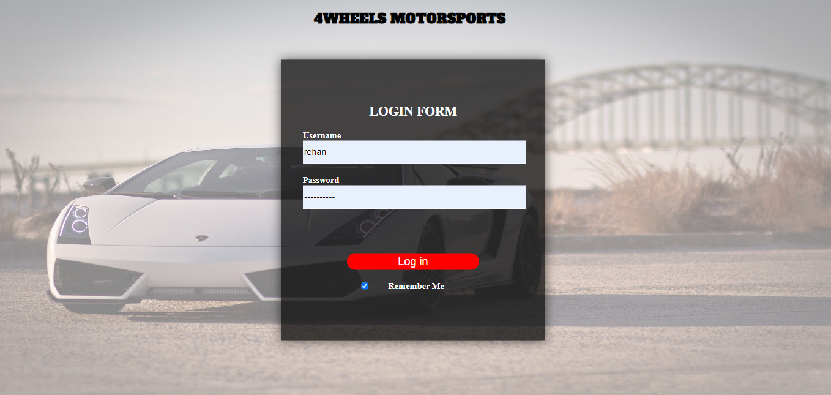
Login Page:

Slide 25
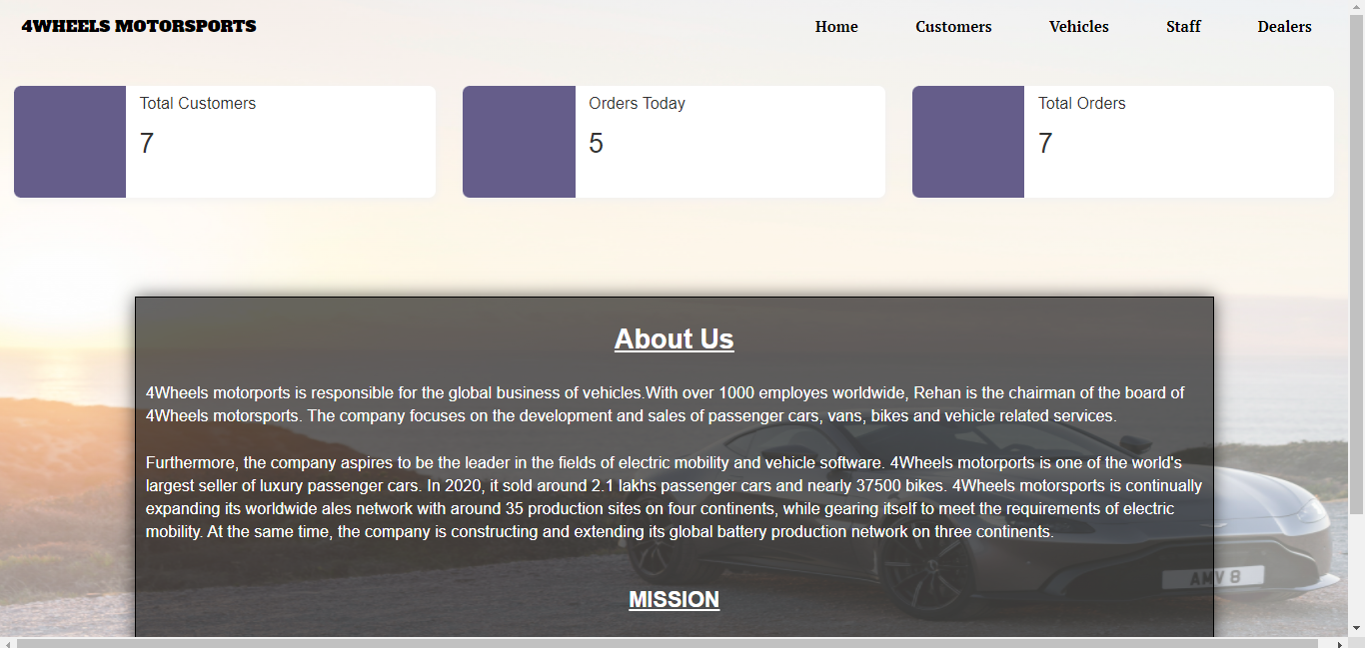
Home Page:

Slide 26
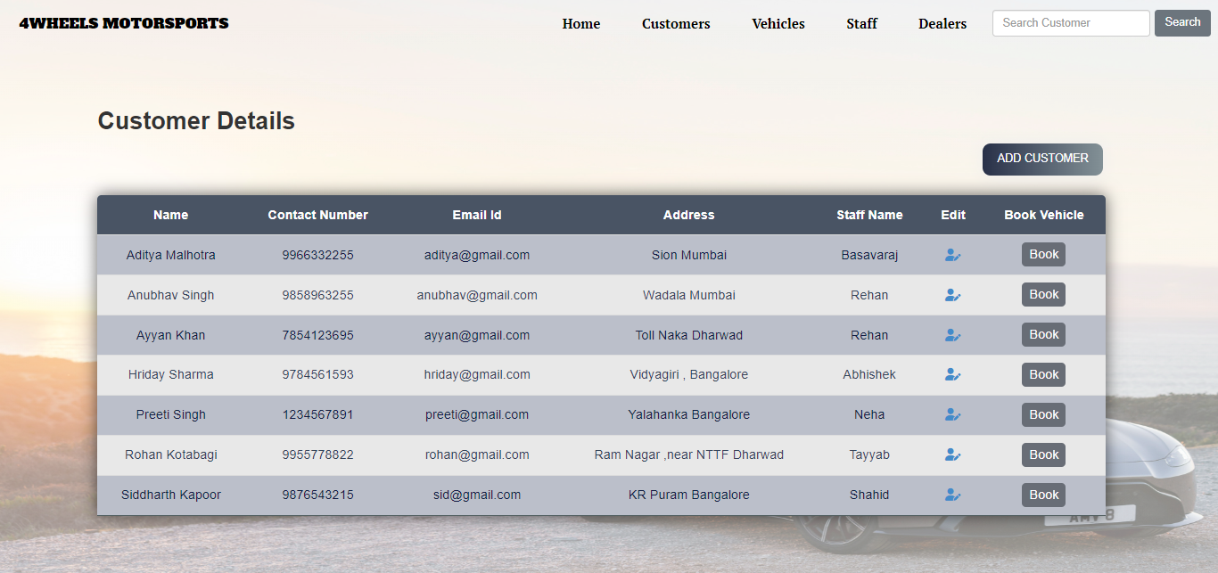
Customer Details Page:

Slide 27
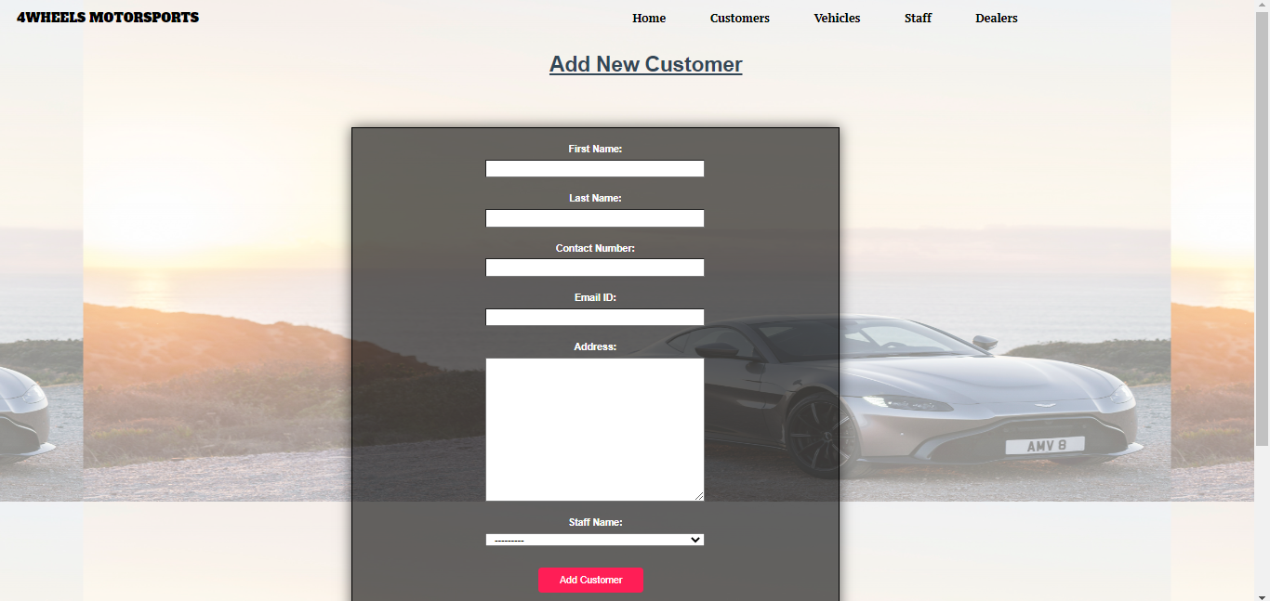
Add Customer:

Slide 28
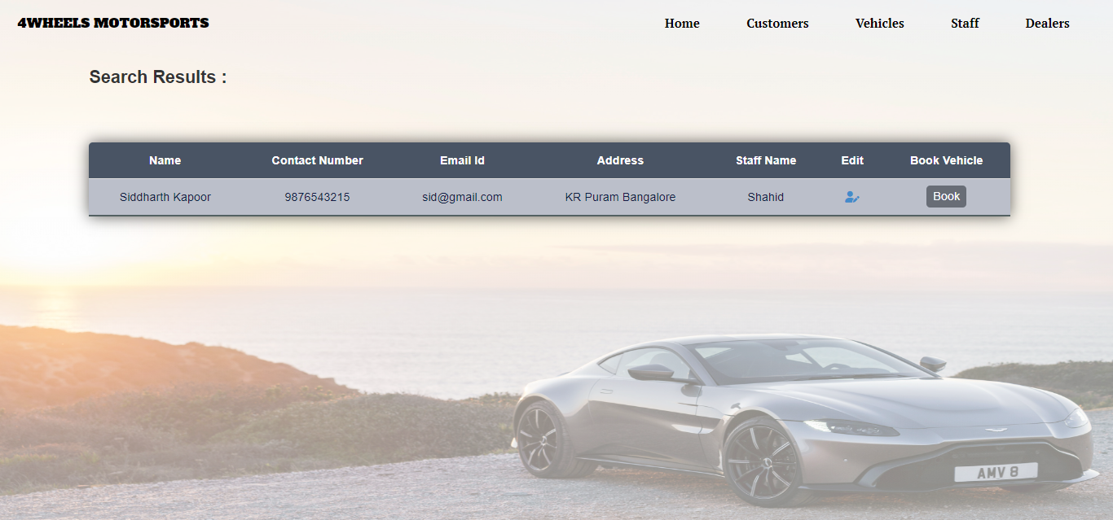
Search For Customer:

Slide 29
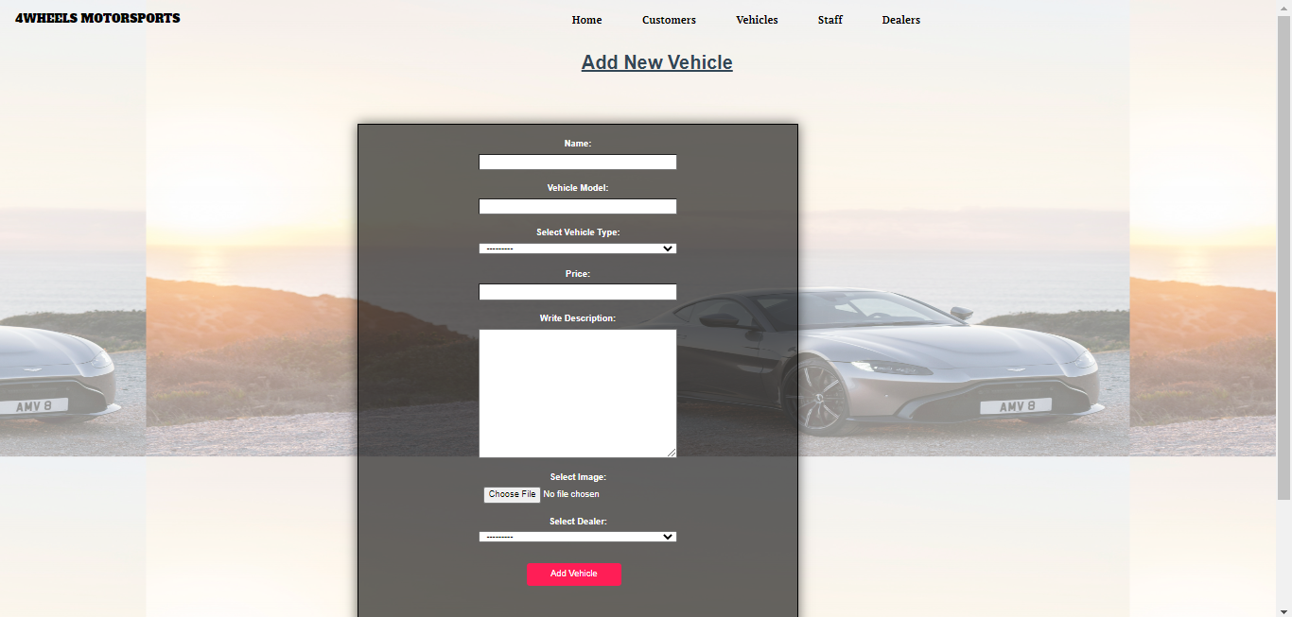
Add Vehicle:

Slide 30
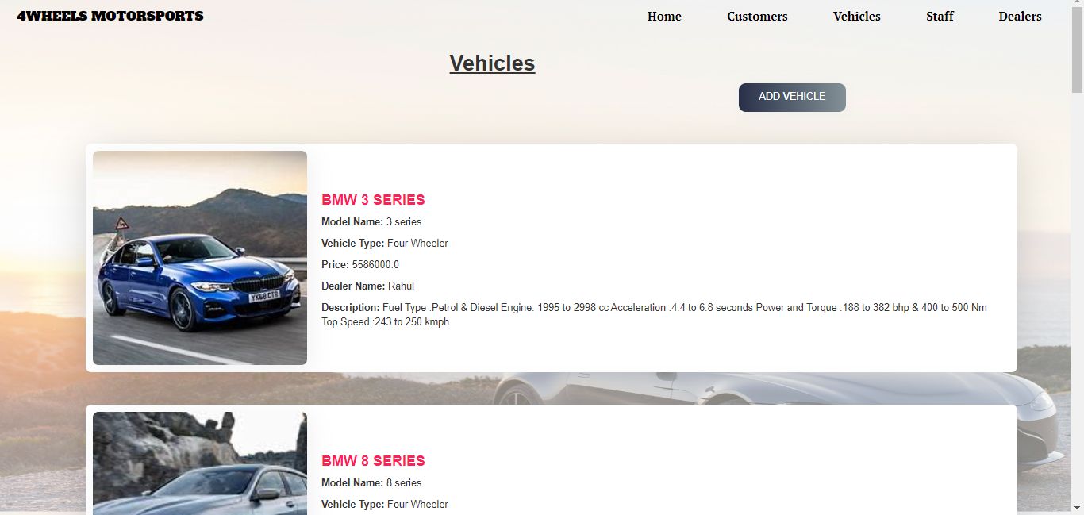
Vehicles Details page:

Slide 31
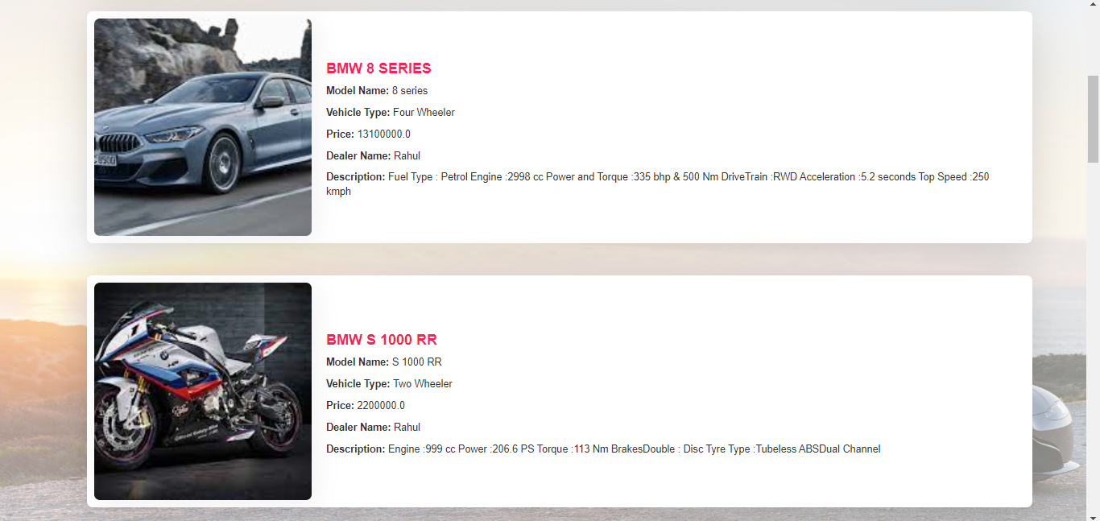

Slide 32
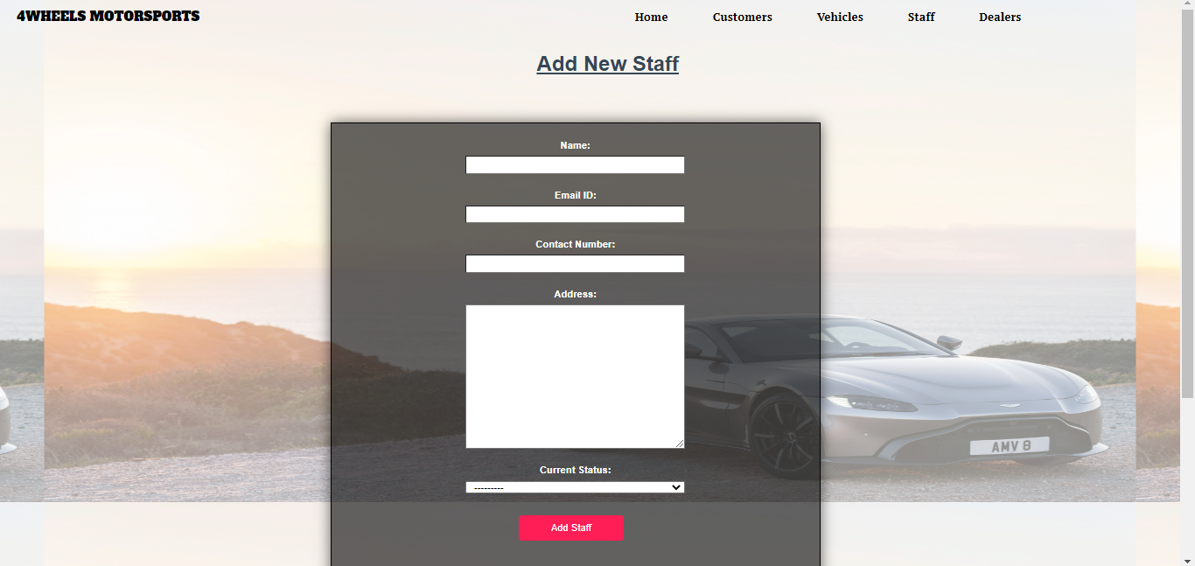
Add Staff:

Slide 33
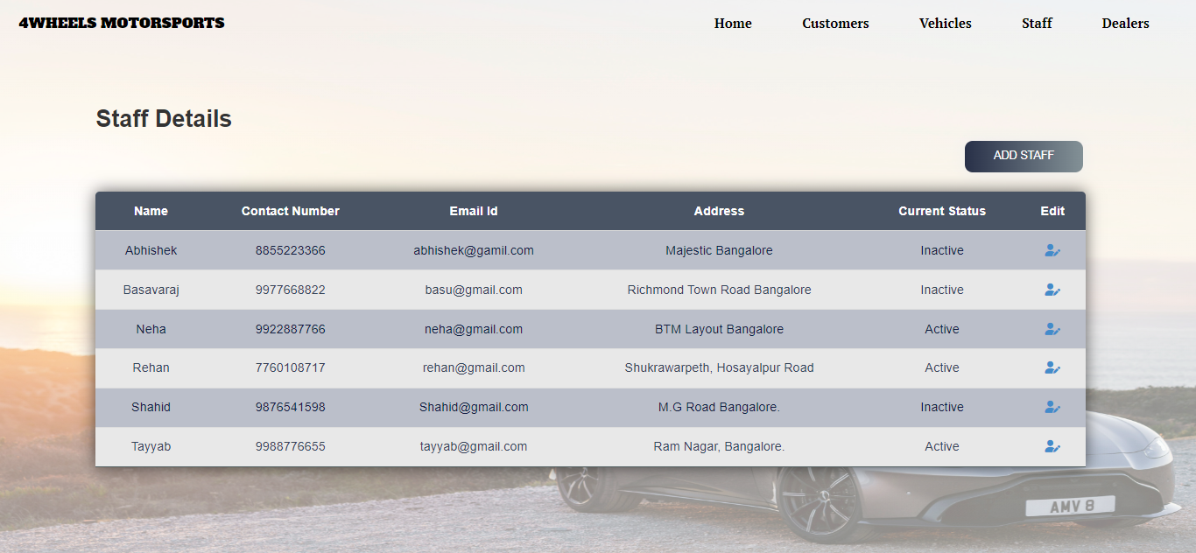
Staff Details Page:

Slide 34
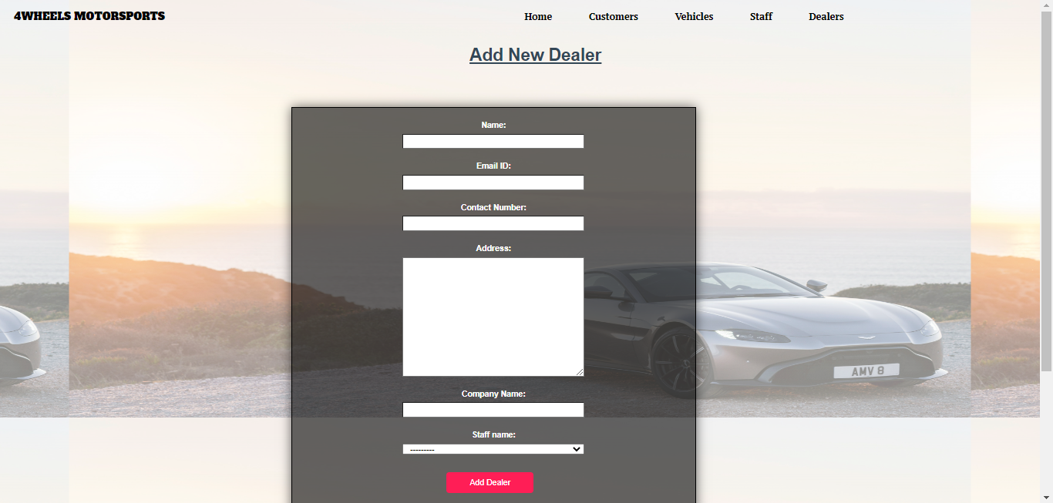
Add Dealer:

Slide 35
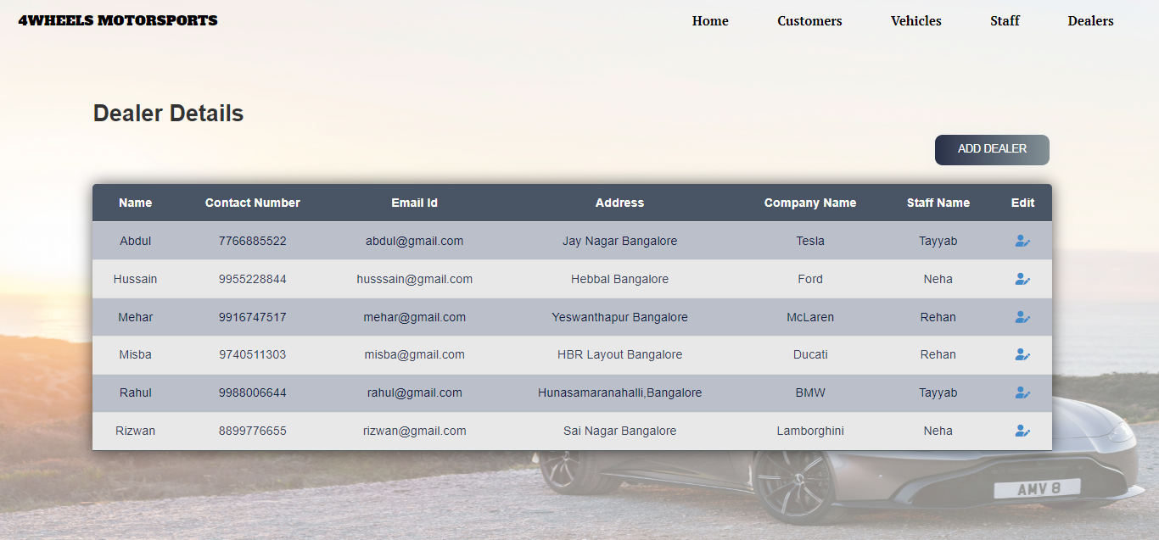
Dealer Details Page:

Slide 36
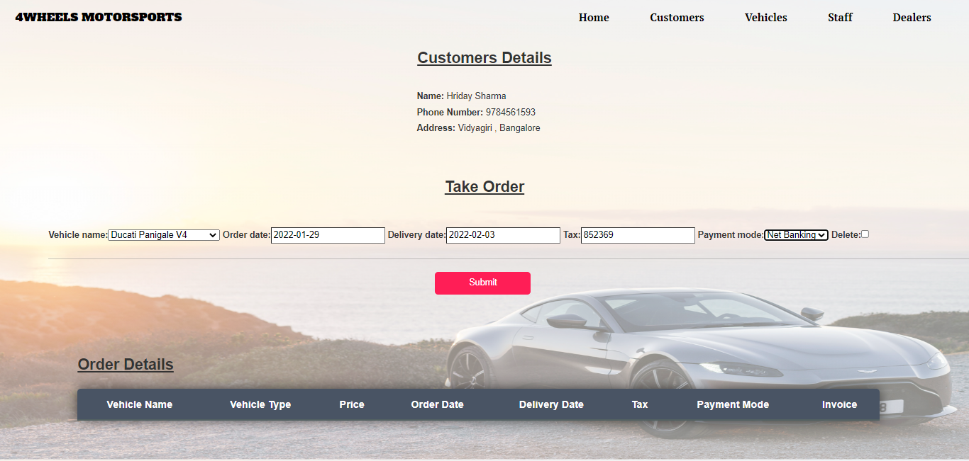
Booking Vehicle:

Slide 37
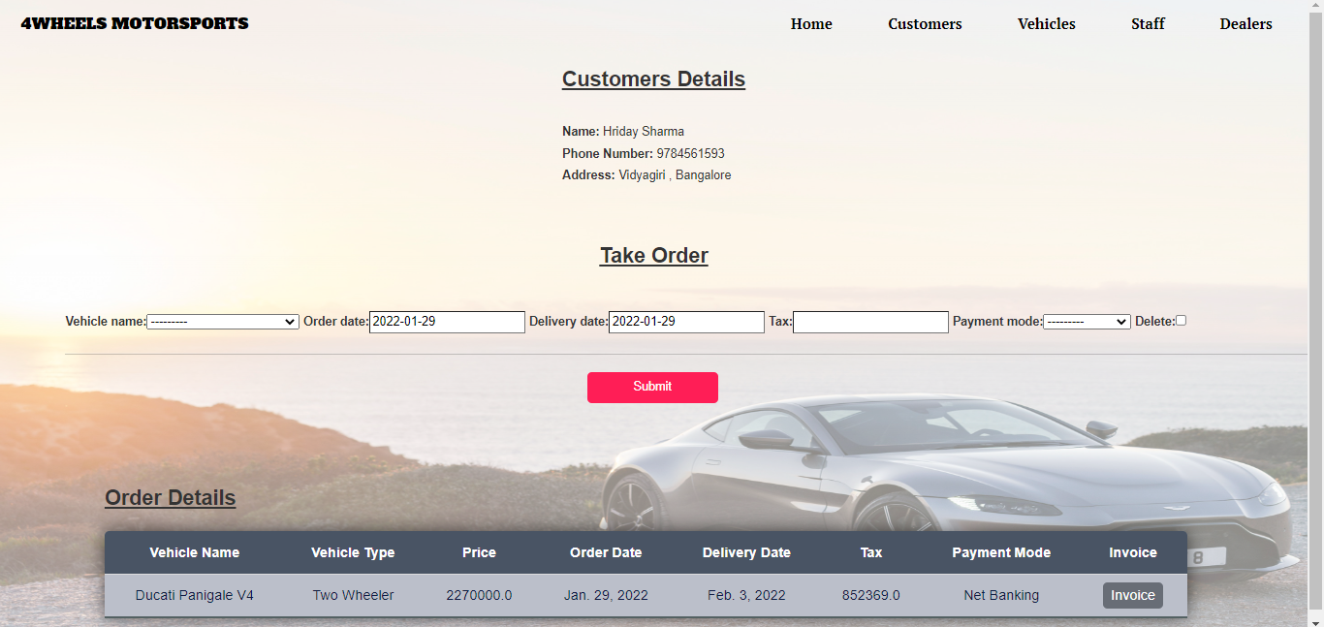
Order Details:

Slide 38
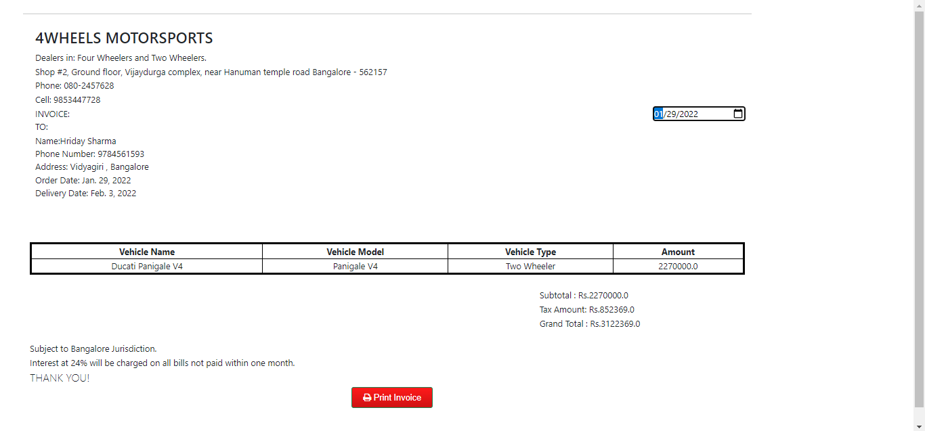
Invoice Page:

Slide 39
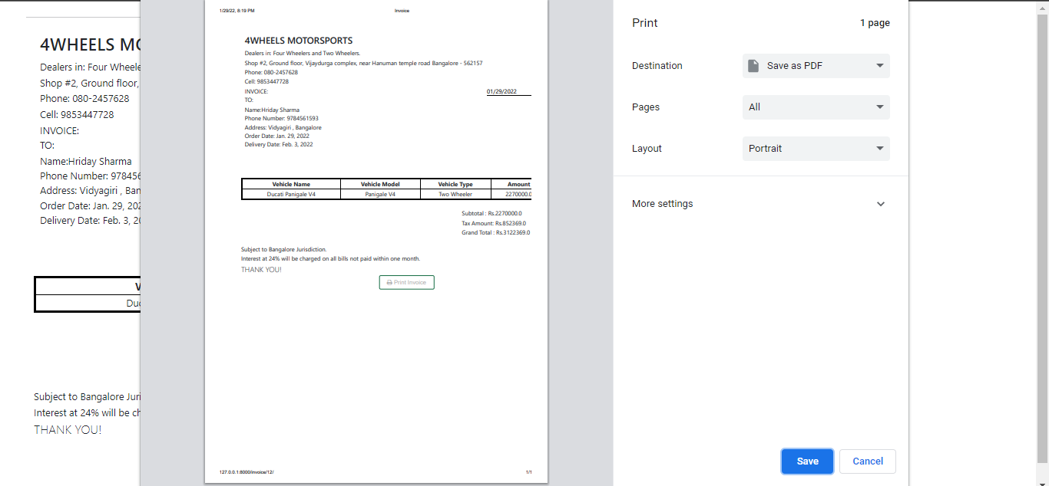
Generated Invoice:

Slide 40
Conclusion:
A secure database and a website is developed that is admin friendly.
Admin can now easily store, update, and even can add new records such as records of customers ,vehicles and much more.
Admin can now easily generate invoice and receipts there by saving a lot of paper.
Admin can now easily search for a particular record from a vast dataset in a fraction of second.

